Slide 1
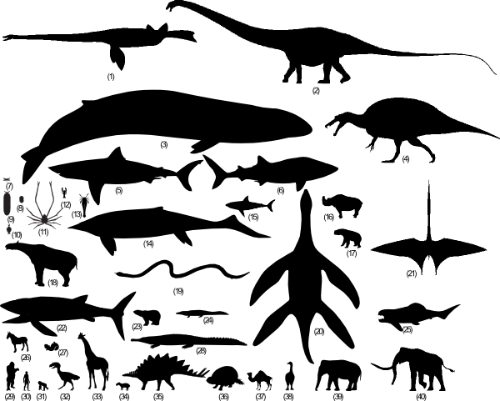
Size through fossil record

Slide 2
Size selective pressure
1. Improved ability to catch prey (usually…) or ward off predators
2. Greater reproductive success
3. Increased intelligence (with brain size)
4. Better stamina
5. Expanded size range of acceptable food
6. Decreased annual mortality
7. Extended individual longevity
8. Increased heat retention per unit volume.

Slide 3
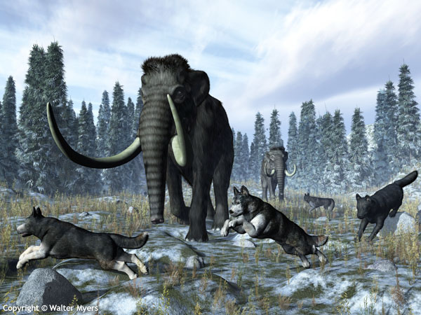
Lost Giants

Slide 4
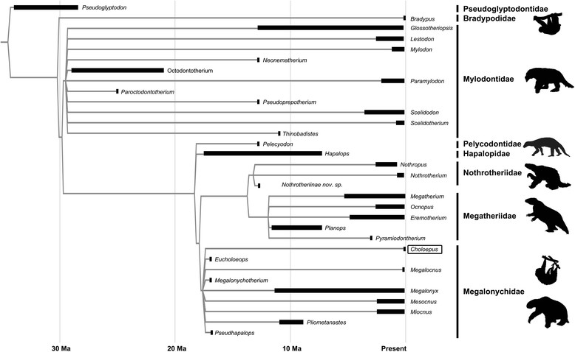
Sloth Clade

Slide 5
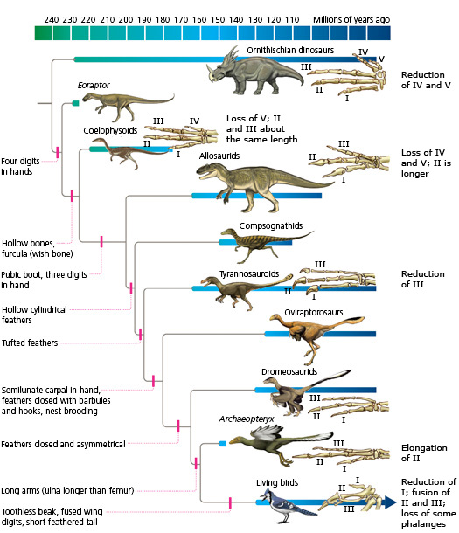
From Dinosaur to Birds

Slide 6
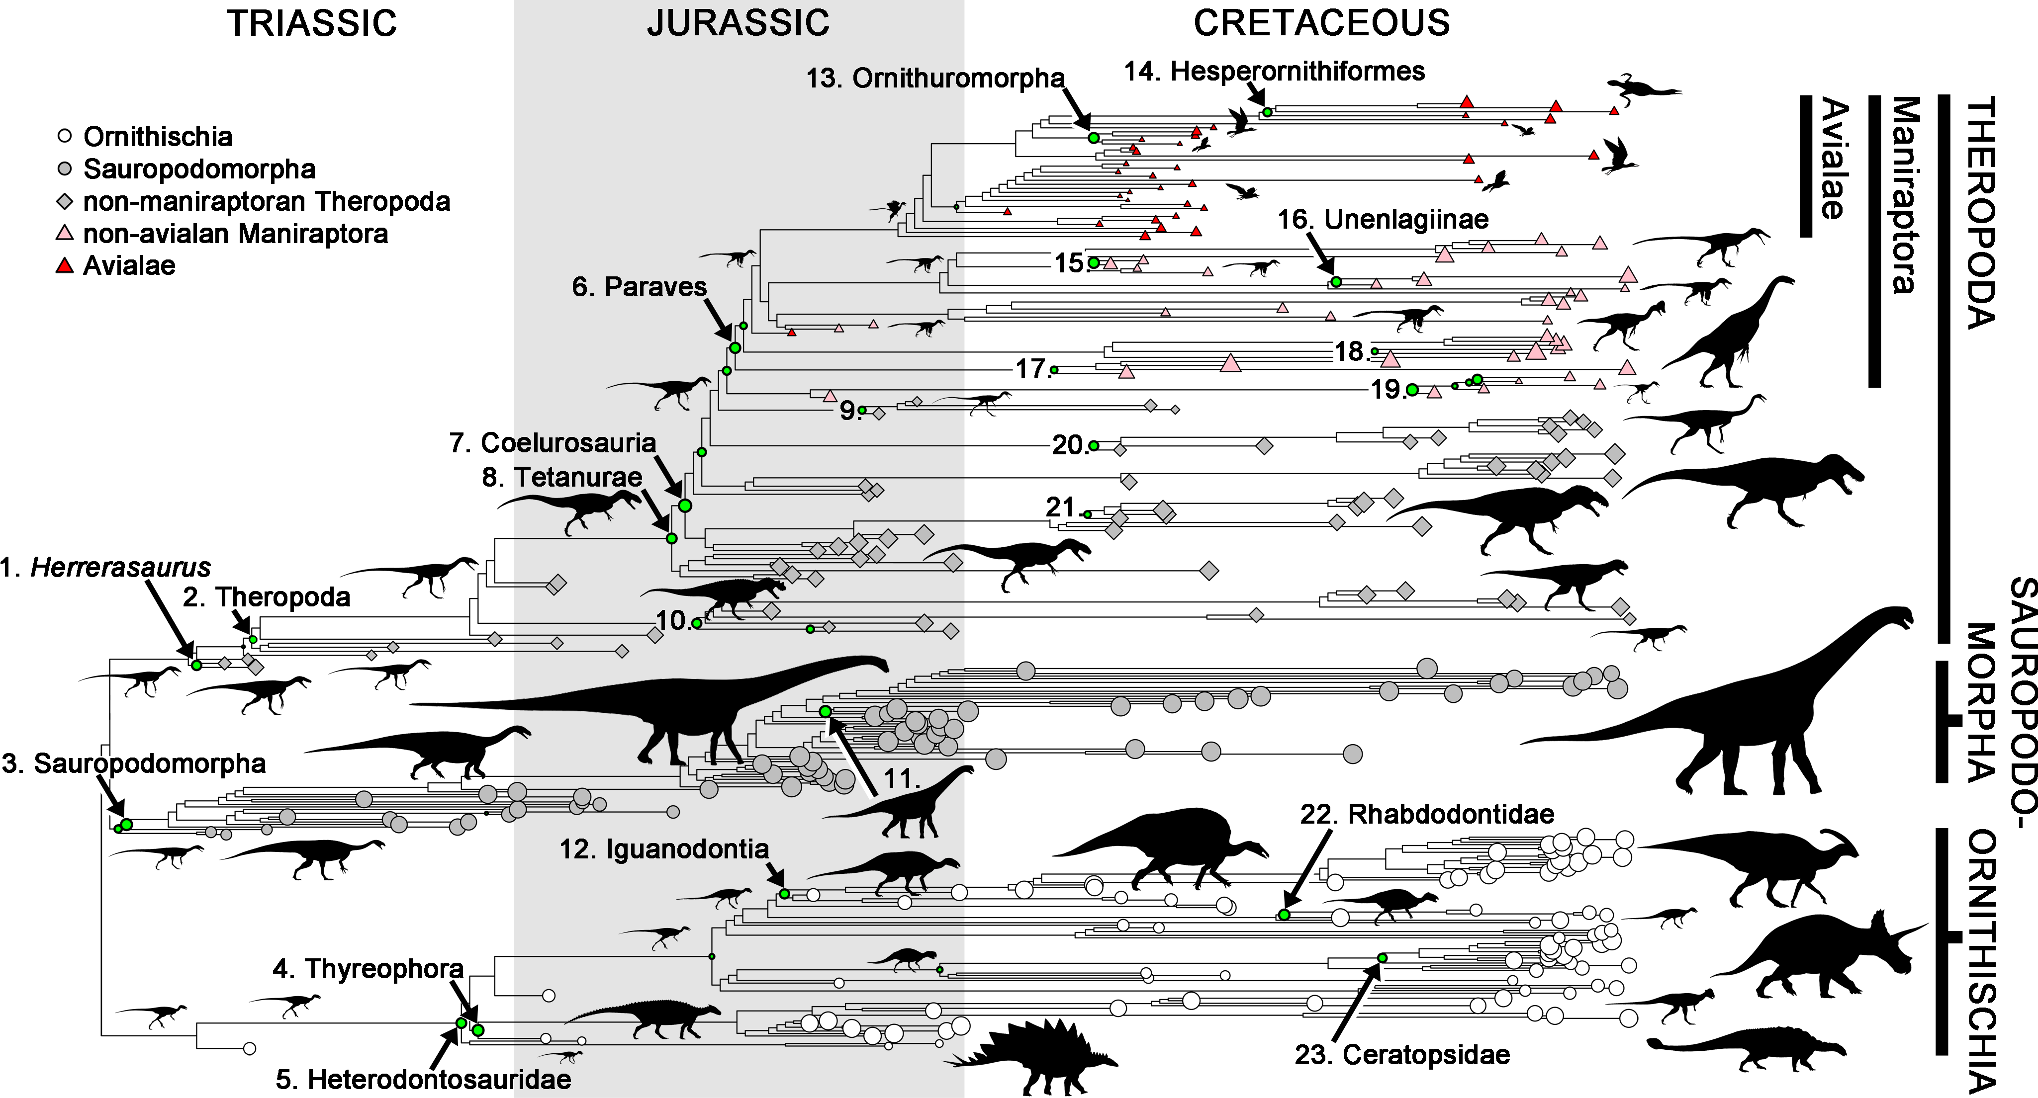
Herbivore Dinosaur size

Slide 7
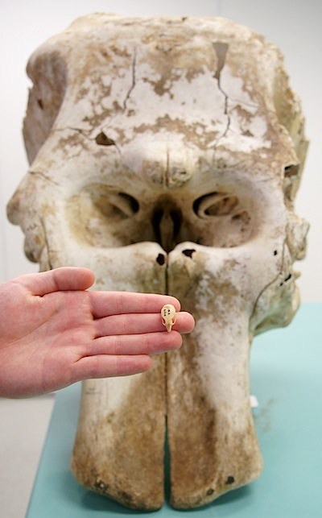
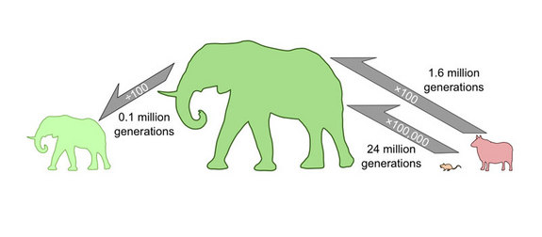
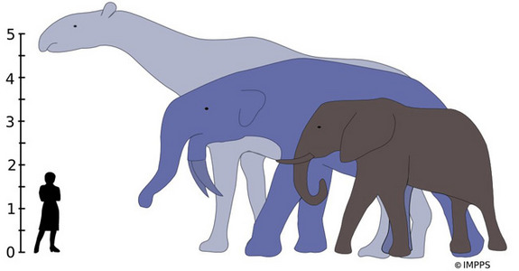
Mammals sizes

Slide 8

Oxygen and Giant Insects

Slide 9
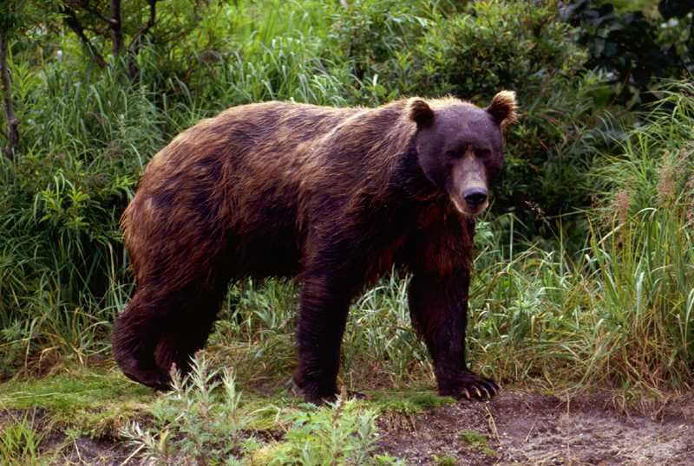
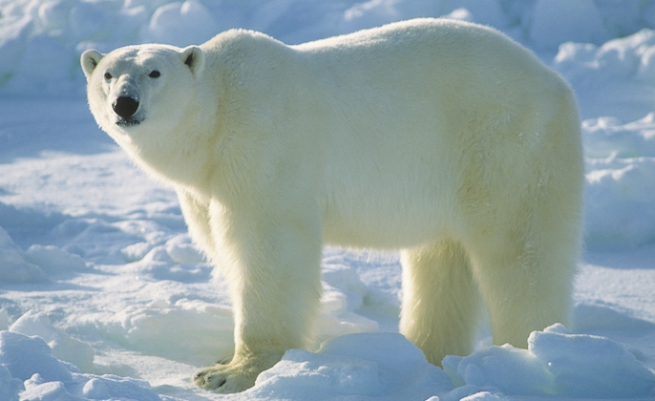
Bergmann's rule
Bergmann's rule states that within a broadly distributed taxonomic clade, populations and species of larger size are found in colder environments, and species of smaller size are found in warmer regions.

